Slide 1

Team G-MAGNUS
Problem Statement : Students consume content from PDFs and videos but lack an
intelligent system that measures understanding, predicts forgetting,
and adapts learning difficulty. Existing tools generate notes but do not
improve long-term retention or concept mastery.

Slide 2
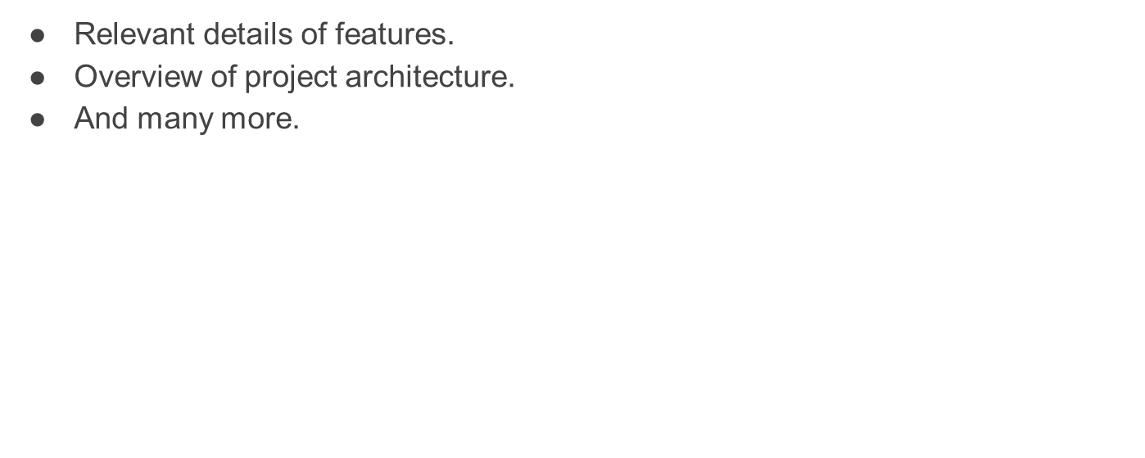
Overview
StudyGenie AI is an adaptive multimodal learning system that:
• Converts PDFs and videos into structured knowledge
• Generates concept-based quizzes
• Detects weak areas at concept level
• Tracks skill progression using LevelUp AI
• Schedules revision using forgetting-curve logic
The system transforms passive studying into measurable skill growth.

Slide 3
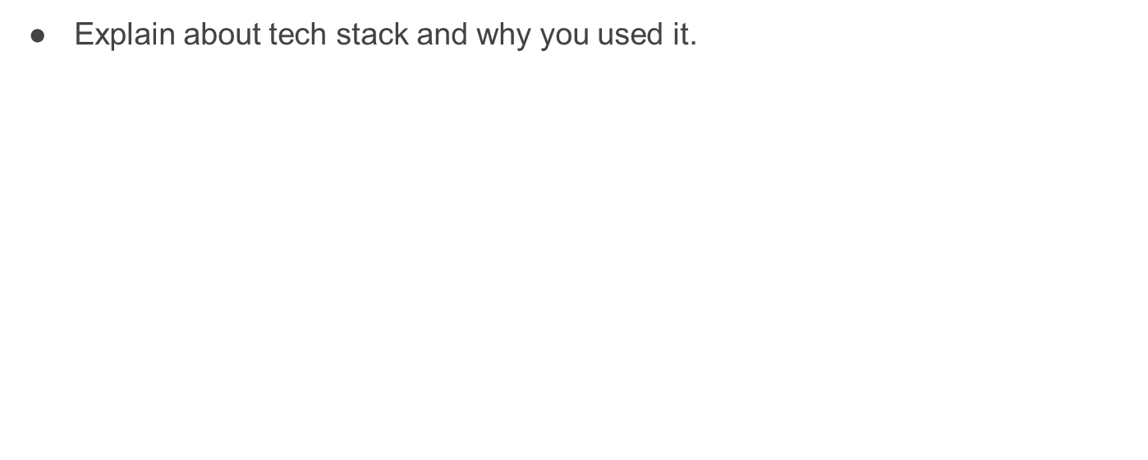
Frontend
React / HTML + Dashboard UI
Backend
FastAPI (Python)
AI & Processing
Whisper (Speech-to-Text) : Accurate transcription
Google Gemini API (Content Understanding & Quiz Generation)
Sentence Transformers (Embeddings)
FAISS (Vector Search)
Database
Performance Tracking Store
Vector Database for Semantic Search

Slide 4
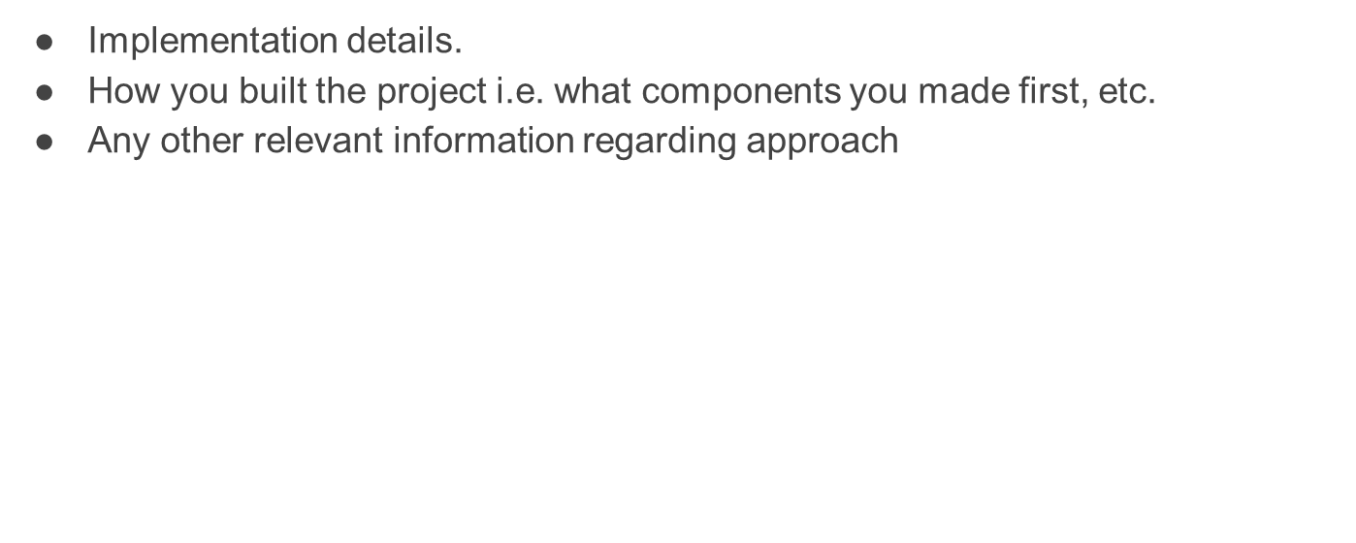
Backend Components
Intelligence Logic
Frontend
• Content chunking
• Semantic embedding storage
• Adaptive difficulty rules
• Forgetting-curve simulation
• Upload interface
• Quiz UI
• Progress dashboard
• Concept mastery visualization
• File upload APIs
• PDF text extraction module
• YouTube transcript fetching
• Quiz generation API
• XP calculation logic

Slide 5
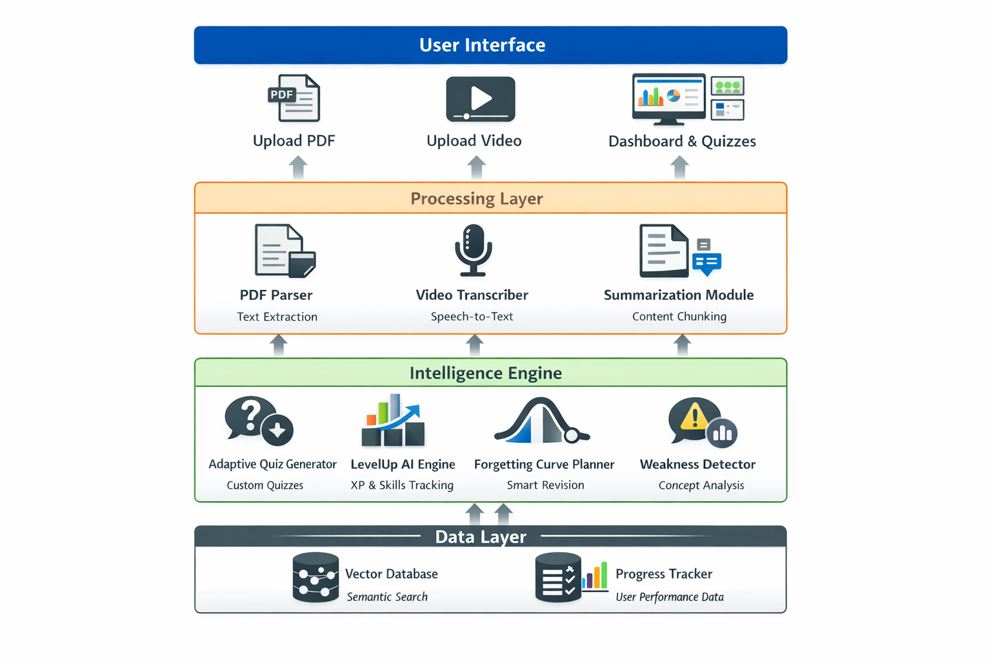

Slide 6
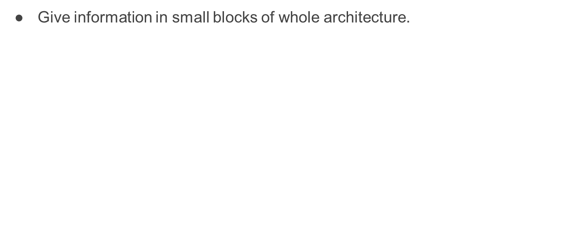
Architecture Overview – StudyGenie AI
1 User Layer
• PDF & Video Upload
• Quiz Interface
• Progress Dashboard
• Concept Mastery View
2 Processing Layer
• PDF Text Extraction
• Video Speech-to-Text
• Content Chunking
• Semantic Structuring
3 Intelligence Engine (Core Brain)
  Adaptive Quiz Generator
  Weakness Detection
  Forgetting Curve Planner
  LevelUp AI (XP & Skill Tracking)
4 Data Layer
  Vector Database (Semantic Search)
  Performance Database
  Concept Embeddings
  Analytics Storage
User → Processing → Intelligence → Data → Personalized Feedback Loop

Slide 7

· Github :
https://github.com/greddy9499/StudyGenie.git
·

